Slide 1
Internet of Things Offerings

Slide 2





IoT is driving digital disruption of the physical world
Accelerating advances
in technology
Are transforming every part of business
Boosting operational performance and lowering costs
Cognitive Analytics
Cloud Computing
Driving engagement and customer experience
Pervasive Connectivity
Product Lifecycle
Management
Creating new products and business models
Embedded sensors
Advancing environmental leadership

Slide 3
With IoT, companies are becoming more competitive with new ways to drive better business engagement
Can I reduce maintenance costs by doing condition repairs instead of time-based maintenance
How can my business deliver better client experience or better outcomes with IoT
How much energy cost can I reduce?
How can I increase the utilization of my assets?
We need to create multiple variants of our products for different markets
How can I prevent or anticipate massive recalls?
I need to reduce risk developing this complex device
How much more revenue can I generate from my current assets?
I have assets deployed all over the place that need a repair process
I need to reduce/eliminate my factory downtime due to unplanned outages
How can I detect quality issue and minimize scrap?
I need help managing complex development projects
How can I best support our organization's environmental sustainability objectives?
I have to prove we met regulatory specs to an auditor!
I need to find new sources of revenue by moving to new service-business models
I need to reduce the cost of running my building

Slide 4





























Clients tackling business challenges today with Watson IoT

Slide 5











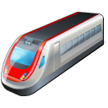
With IoT, you can…
IBM Watson IoT Solutions
Rapidly and securely connect devices
Optimize operations
Operations
Asset Performance
Facilities Mgmt
Health & Safety
Product
Development
Work Mgmt
Connected Products
Enable new business models
IBM Watson IoT Platform
Engage with clients and markets in new ways
Facilities
Factories
Vehicles
Home
Health
Transport

Slide 6

3 Steps to enable value
Platform
Packaged Apps
Transforming Business
Connect your devices simply and securely to the Watson IoT Platform. Use the API’s in the Platform to bring in Cognitive, Weather, Analytics, Security, and data streaming capabilities.
Push platform data into packaged IBM applications that optimize your operations and drive better business outcomes such as reliability, productivity, and risk.
Transform the way business gets done as a Cognitive enterprise. Connect businesses to their clients.
IoT Offerings
IoT
Industry Offerings
Additional Cognitive Offerings
Unique value delivered
Predictive Maintenance
Enterprise Asset Management
IoT Platform Information Management (incl. Weather APIs)
Continuous Engineering
Client value realized
IoT Platform Connect
Facility & Real Estate Management
IoT Platform Analytics (incl. Cognitive APIs)
IoT Platform Risk Management
Decision support for usage drive design, warranty management, client up-sell
Improved client experience
Reduced operational costs
Reduced health / safety risk
Capture new revenue opportunity
Transform client experience and engagement
Lead / participate in industry re-ordering
Visibility into product usage
Rapid innovation / experimentation
Improved operational efficiency
Time, Maturity and Scale of Adoption

Slide 7
IoT value strategy
Looking to connect…
Devices? Equipment? People?
Start with the Watson IoT Platform
Connect
Connect to…
Secure connectivity
Manage devices
Information Management
Store and archive data
Weather APIs
Structure and unstructured
IBM Watson IoT Platform
Analytics
Real time
Predictive
Cognitive
Risk Management
Data protection
Security analytics
Blockchain
Facilities
Factories
Vehicles
Home
Health
Transport

Slide 8





IoT value strategy
Looking to optimize…
Assets? Product Development? Safety
Start with the IoT Applications
Improve space utilization
Reduce energy usage
Operations
Asset Performance
Facilities Mgmt
Facility & Space
Health & Safety
Reduce time to value
Improve lease management
Product
Development
Work Mgmt
Connected Products
Real Estate
Optimize resources
Increase ‘re-use’
IBM Watson IoT Platform
Product Development
Operational risk
Increase reliability
Predictive Maintenance
Life cycle management
Configuration management
Facilities
Factories
Asset Management
Vehicles
Home
Transport
Health

Slide 9
IoT value strategy
Looking to transform traditional business with IoT…
IBM Watson IoT Solutions
Invent new business models
Develop differentiated solutions
Improve operational efficiency
Drive better customer engagement
Utilize IBM innovation and a Consult to Run partnership
Operations
Asset Performance
Facilities Mgmt
Health & Safety
Product
Development
Work Mgmt
Connected Products
IBM Watson IoT Platform
Facilities
Factories
Vehicles
Home
Health
Transport

Slide 10
IBM Watson IoT Platform

Slide 11
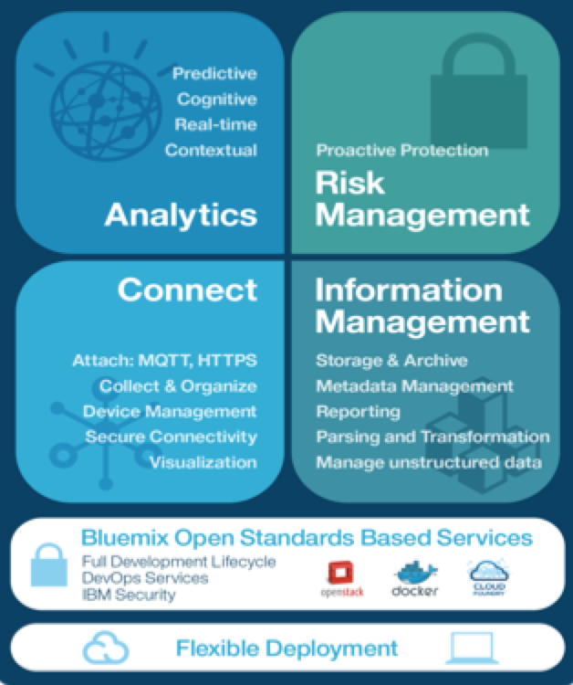
The IBM Watson IoT Platform Everything you need to Innovate with IoT
Third Party Apps
Third Party Apps
IBM Watson IoT Platform Connect
Attach, Collect, & Organize, Device Management, Secure Connectivity, Visualization
IBM Watson IoT Platform Information Management
Storage & Archive, Metadata Management, Reporting, Streaming data, Parsing and Transformation, Manage unstructured data
Weather APIs
IBM Watson IoT Platform Analytics
Predictive, Cognitive, Real-time, and Contextual
IBM Watson IoT Platform Risk Management
Security Analytics, Data Protection, Auditing/Logging, Firmware Updates, Key/Certificate Mgmt, Org Specific Security.
Blockchain (Beta)

Slide 12

Risk Management and Blockchain capabilities for better security and privacy
Providing the ability to enforce the appropriate level of security and privacy to your IoT solution from the device through the network to the cloud and beyond
End to end core security features
System wide confidence via Security Analytics and Device Management
Support for secure decentralized systems with Blockchain
Blockchain

Slide 13
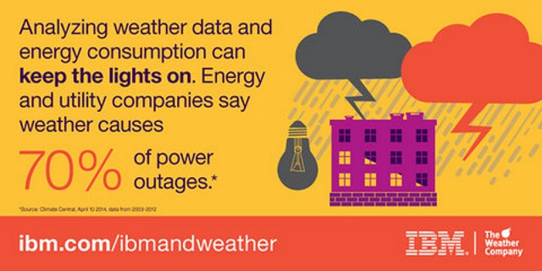
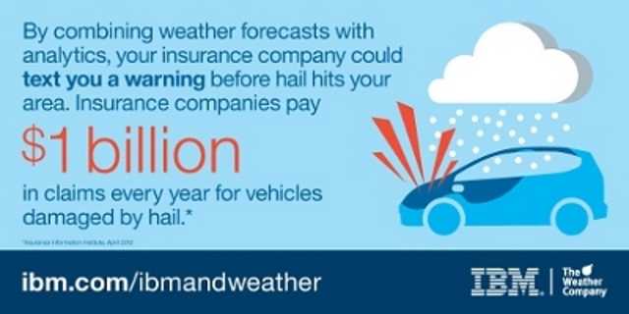
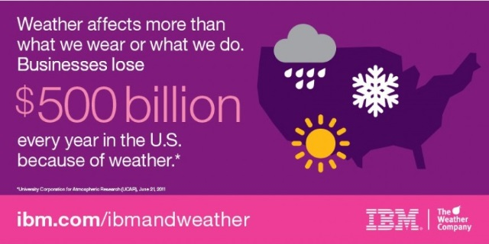

Combining weather, analytics, and internet of things to deliver better outcomes
Weather assets fuel IoT transformation across industries
Incorporate weather data into your IoT applications
Combine weather data in your data set to gain more insight
“Insights for Weather” API now available on Bluemix
Weather Data

Slide 14
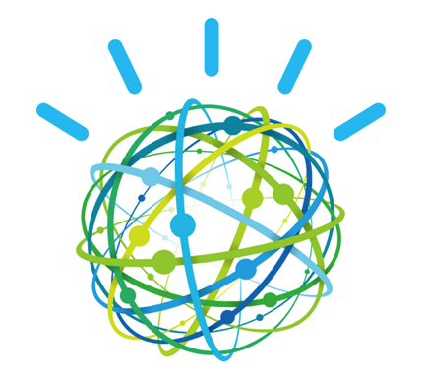
Adding analytics capabilities to IoT data produces the intelligence of cognitive IoT
Cognitive
Natural Language Processing
Video/Image/Audio Analytics
Machine
Learning
Text Analytics

Slide 15
IBM IoT Applications Asset and Facility Management

Slide 16







IBM IoT Applications increases performance and value of Asset and Facility Management
Facility & Real Estate Management
Enterprise Asset Management
Facility & Space
Work Management
Process Automation
ANALYTICS
Real Estate
Supply Chain
Asset Management
MOBILITY
Energy & Sustainability
Health & Safety
Configuration Management
SUPPLY
CHAIN
Capital Projects
Service Providers
Industry Solutions
Common Platform Services
Asset, Device, System Infrastructure Interaction

Slide 17











Enterprise Asset Management with Performance Management drives to advanced stages of Asset Maturity
IBM Maximo
Instrumented
Interconnected
Intelligent
Ever increasing range of sensors
Volume, velocity, variety
Event driven information
Agility and Mobility
Highly Connected Systems
Cross Collaboration
From data to actionable intelligence
From reactive to proactive
Whole lifecycle system optimization
Asset Management and Facilities Maturity
Absent
Cognizant
Evolving
Proficient
Advanced
Costs
Performance
Usage based
Condition based
Predictive
Risk based
Calendar based
Maintenance is an Expense
Time and Effort
Maintenance is an Investment
Enterprise Asset Management
Asset Performance Management

Slide 18
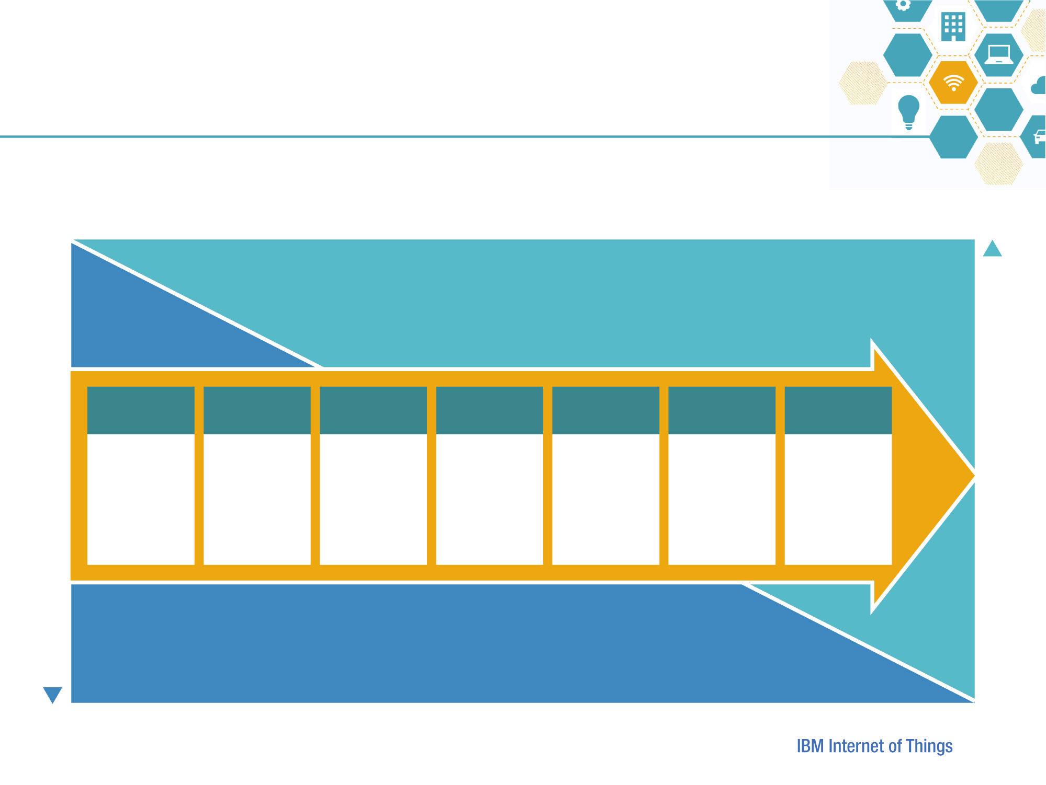
Real Estate and Facilities Performance Management drives utilization and financial return on assets
IBM TRIRIGA
REAL ESTATE AND FACILITIES PERFORMANCE MANAGEMENT
Drive asset effectiveness
MOBILE
CLOUD
PERCEPTIVE
APPLICATIONS
BIM
COGNITIVE
ANALYTICS
PRESENCE
DETECTION
FINANCIAL
ANALYTICS
EXTEND
REFM to more people in more places
REDUCE
cost of REFM
operations
across
departments
SIMPLIFY
REFM tasks on more devices
PINPOINT
planning, maintenance for each REFM asset
IDENTIFY
trends and patterns in the REFM portfolio
INCREASE
asset
Utilization
across REFM
portfolio
OPTIMIZE
financial return
on REFM
investment
INCREASE ASSET UTILIZATION AND ROA
REDUCE SPACE-RELATED EXPENSES
INTEGRATED WORKPLACE MANAGEMENT SYSTEMS
Drive operational efficiency

Slide 19
IBM IoT Applications Predictive Maintenance & Quality

Slide 20











IBM Predictive Maintenance and Quality
Reduce
operational costs
Accelerate time to value
Real-time capabilities
Big data, predictive analytics, business intelligence
Quicker and more-accurate decision making
IBM Maximo® integration
Open architecture
Advanced quality algorithms
Available SaaS and On Premise
Improve asset productivity
Increase
process efficiency

Slide 21





IBM PMQ enables better business outcomes
Monitor, maintain and optimize assets for better availability, utilization and performance
Predict asset failure and identify poor quality parts earlier to better optimize operations and supply chain processes
Reduce guesswork and incorporate experiential knowledge during the decision-making process
Includes foundational models, dashboards, reports and source connectors
Notes:
20

Slide 22

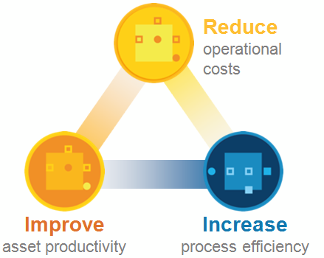
Ultimately affecting the bottom line
Predictive Maintenance
Quality – Lean Sigma
Field Asset Monitoring
Averting unplanned downtime
Scheduled/planned, predictive
Addressing asset utilization
Warranty capabilities
Extend process improvement
Root cause analysis & SPC
Supply chain
Equipment monitoring for production
Asset monitoring for new service(s)
Field asset optimization
Inventory management
Fleet and facilities management
The Value of PMQ
Lowering Unit/Item Cost (Improving profit/margin)
Increasing Production “Yield”(Productivity)
Superior ROA and “Asset Optimization”
Higher Revenue due to Quality Improvement
Increased Competitiveness due to higher Quality
New Services for Health Monitoring of Assets
Lower Risks due to fewer or elimination of Asset Failures

Slide 23
IBM IoT Applications Continuous Engineering

Slide 24

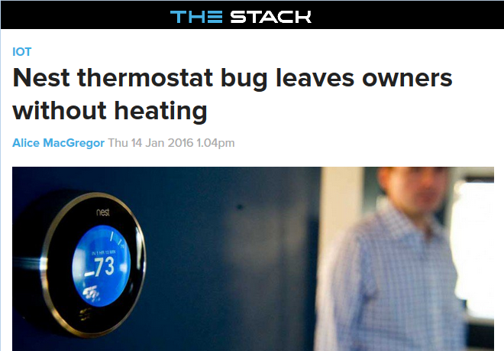
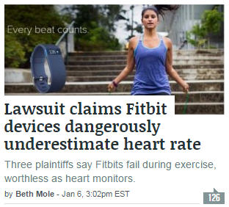
Where human safety is a factor, even simple devices and systems require careful engineering to reduce risk

Slide 25
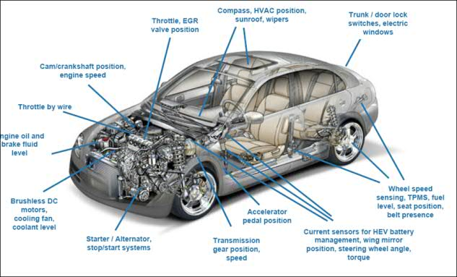
Keeping hardware & software versions & configurations straight is a challenge when designing, manufacturing, and operating “things”
B
A
M
C
D
H
A
D
Z
H
A
B
C
D
H
A
B
A
L
G
M
B
C
D
B
C
D
M
C
D
J
Z
H
A
H
J
M
Z
H
A
Z
A
H
L
G
B
C
D
A
L
G
B
C
D
L
M
Z
H
A
C
D
M
Z
H
J
M
B
Z
C
D
J
B
A
L
G
M
B
C
D
H
J
L
G
L
G
M
C
D
J
Z
H
J
A
Z
H
L
A
M
B
C
D
L
G
M
B
C
D
Z
H
J
Z
H
A
L
G
B
A
L
G
M
B
C
D
M
C
D
J
Z
H
A
Z
A
H
L
G
B
C
D
L
M
Z
H
A
M
B
C
D
J
A
L
G
B
C
D
Z
H
B
C
D
M
Z
H
J
L
G
M
Z
H
J
L
G
L
G
B
A
M
C
D
H
A
D
Z
H
A
B
C
D
H
A
B
A
L
G
M
B
C
D
B
C
D
M
C
D
J
Z
H
A
H
J
M
Z
H
A
Z
A
H
L
G
B
C
D
A
L
G
B
C
D
L
M
Z
H
A
C
D
M
Z
H
J
M
B
Z
C
D
J
B
A
L
G
M
B
C
D
H
J
L
G
L
G
M
C
D
J
Z
H
J
A
Z
H
L
A
M
B
C
D
L
G
M
B
C
D
Z
H
J
Z
H
A
L
G
B
A
L
G
M
B
C
D
M
C
D
J
Z
H
A
Z
A
H
L
G
B
C
D
L
M
Z
H
A
M
B
C
D
J
A
L
G
B
C
D
Z
H
B
C
D
M
Z
H
J
L
G
M
Z
H
J
L
G
L
G
Each sensor contains a software tree with a complexity of options, models, fixes and releases that must be managed

Slide 26
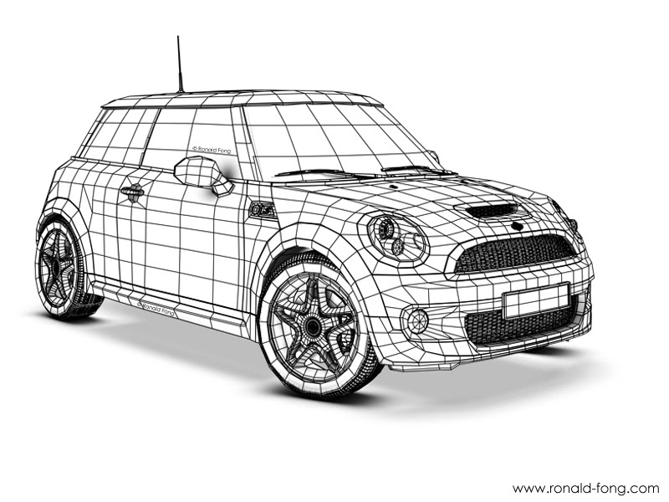
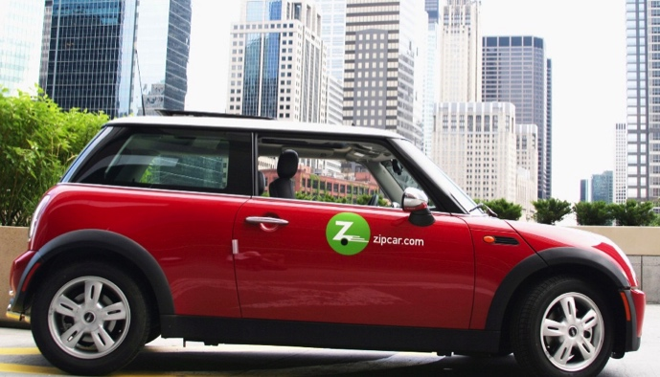

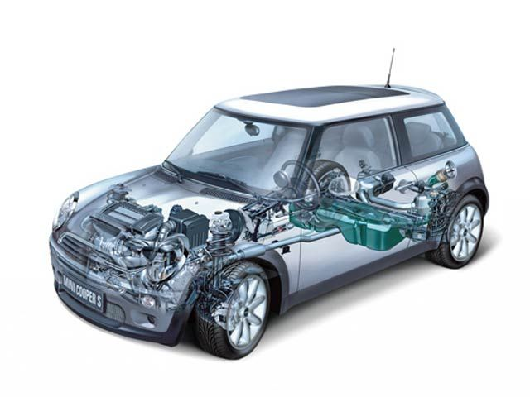
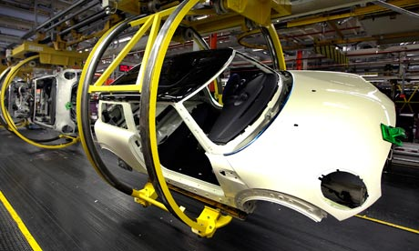
IBM IoT Continuous Engineering Everything you need to Create Disruptive Devices with IoT
IBM Rational DOORS Next Generation
Collect, Organize and Collaborate to define Requirements
IBM Rational Team Concert
Plan, manage and develop products and software
IBM Rational Rhapsody and Design Manager
Design, prototype, execute system and software models and code
IBM Rational Quality Manager
Define, manage and execute tests
IBM Rational Engineering Analytics
Understand complex interactions between Requirements, Plans, Designs and Tests to prove Compliance and Completeness
IBM Rational Method Composer
Extend, Capture, Enforce and leverage Industry and Company best practices
Secure Cloud Distribution
Real-time Performance Insight
Data
Enhancement
Condition Based Maintenance
Cognitive
Analysis
New Deployments
Product updates and
OTA
Device Configuration Management
Analytics for Design
Engineering Data
Analytics
Condition and Performance Monitoring
Data Aggregation
Sensors
Customer
Needs
Requirements Engineering
Manufacturing
Deployment / Sale
Deployment/
Release to Mfg.
System Requirements
Design for Analytics
System Verification and Validation
System Design
Virtual Verification
Integration & System Test
Implementation

Slide 27
IBM IoT Industry Transformation Solutions

Slide 28
IBM IoT Transformational Offerings Enabling new business models with integrated solutions
Automotive
Retail
Electronics
Industrial Products
Insurance
Aviation
Energy & Utilities
Chemical & Petroleum
Transport
Healthcare
Transform traditional business with the capabilities of IoT
Invent new business models
Develop differentiated solutions
Improve operational efficiency
Drive better customer engagement
Utilize IBM innovation
Available now or 1H ‘16
Future

Slide 29
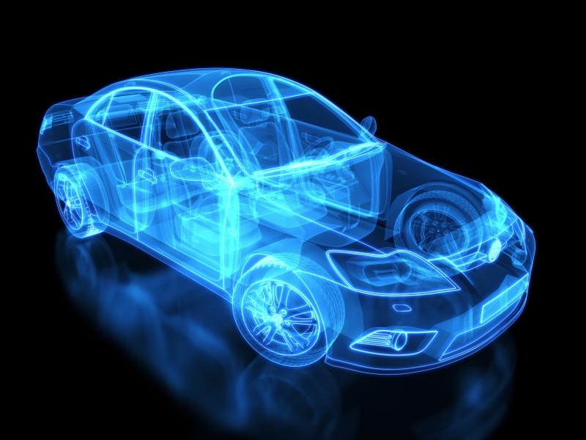
IBM IoT for Automotive
IoT for Automotive made for the development and operation of world leading connected vehicles
Analytics driven off of extensive data
Value from Actionable Insights
Massively scalable and in real-time
Automotive
Helping automotive manufacturers gather data from individual sensors, combine this data with other data sources for real-time analysis, and provide actionable insights for added value

Slide 30

IBM IoT for Electronics
IoT for Electronics enables next generation service delivery of connected products
Simple Device Registration Process
Increased remote functions promote increased engagement
Content Delivery unlock new revenue streams and service models
Electronics

Slide 31
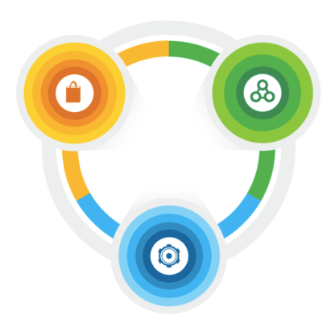



IBM IoT for Retail – Asset Health
Asset health
Store analytics solution
Diagnostic and predictive analytics
IoT-enabled fault detection
Work order integration
Reduced operating costs
Reduced energy footprint
Optimum performance
Lighting | HVAC | Equipment | Checkout | Shelving | Security | Layout

Slide 32
























IBM IoT for Telecom Three value propositions
How do I reassert relevance in B2B Markets?
How do I find new things to sell?
How do I partner to deliver value?
How do I participate in the API economy?
How do I make my offerings ‘cognitive’?
Services
Innovation
How do I manage my fleet, network, masts?
How do I manage my employees?
How do I manage my stores? My sites?
How do I secure my enterprise?
Enterprise
How do I manage signalling?
How do I compete against low power competitors?
How do I secure IoT?
How do I differentiate?
Network
The Watson IoT Platform helps drive “Services Innovation” in particular, and the focus of most discussions with telecom service providers is in this domain. The others are important considerations, however, for our clients.
There may also be Maximo / Tririga / PMQ opportunities in ‘Enterprise’.

Slide 33
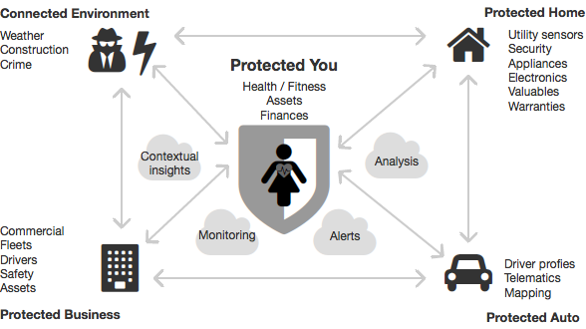
IoT for Insurance
Proactive Protection for the Connected Consumer
Water Leak Detection
Reduced claims
Real time notifications
Personalized risk assessment
Satisfied customers
Protected You (Consumer)
Well being
Assets
Full 360º view of policy holder for the Connected Insurer

Slide 34








IBM is a leader in defining IoT
Participating member in key open standards and industry initiatives

Slide 35
How can IBM help your digital transformation? A trusted partner with proven industry expertise, business solutions, and longevity
IBM’s comprehensive IoT Portfolio to accelerate your transformation
Secure, Scalable, & Open Platform to enable IoT
Watson IoT Platform
Partner Ecosystem
Industry-specific expertise to solve business needs
IoT Applications
GBS Digital Ops Practice
Analytics & Cognitive
Security
Cloud, On-Premise, Hybrid
Industry Solutions
Third Party Solutions
Client experience
Capabilities to help digital businesses become cognitive
Watson capabilities via APIs
GBS’ Cognitive Practice
Digital Transformation and Industry Know-how
Data: Weather, Social, etc…
750 IoT Patents; 3x times any other company 40% faster development with Bluemix and Watson IoT Platform 77k developers using Watson Developer Cloud globally 26B inquires handled daily by The Weather Company platform 10k clients in 133 countries rely on IBM Security solutions 15B events managed daily by IBM Security services
IBM Solutions used globally across various industries 4000 IoT clients worldwide 7 of the 10 largest automotive companies 8 of the 10 largest oil & gas companies 11 of the 20 largest diversified utility companies 6 of the 10 largest energy companies 9 of the 15 busiest airports 11 of the 12 major aerospace and defense companies Over 1400 global IoT Business Partners
350+ Watson ecosystem partners 24+ Watson APIs, powered by 50 cognitive technologies 1.3B Watson API calls processed per month … and growing The industry’s only consulting practice dedicated to Cognitive Business, drawing on 2000 experts in industry dynamics, data science, and analytics

Slide 36



Realize your IoT potential
Learn more about how Watson IoT can help you capitalize on the connected world.
Visit ibm.com/iot

